Slide 1
Basic Chess game A Project Presentation
By- Shubh Gupta 199301305

Slide 2
INTRODUCTION
For my project, I chose to design a Java application that allows two users to play chess. It is built using native java and vanilla java with only inbuilt libraries, which can be further extended to have a chess engine where a player can play against a CPU player(It has not been implemented yet).

Slide 3
TECH:
The chess game is designed by using multiple classes that work together to form the game.
While, the main function of playing chess is present and the application is open to future improvements. Potential improvements include a GUI, finishing the saving/loading system, interfacing with the cloud to play against someone remotely using Hadoop or something similar, etc.

Slide 4
The Various Output and Running of the Chess Game:-

Slide 5
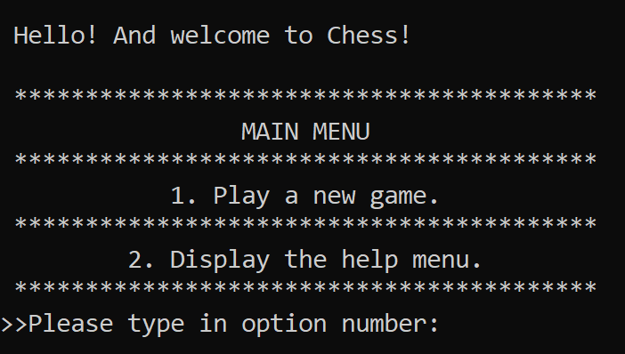
App Start

Slide 6
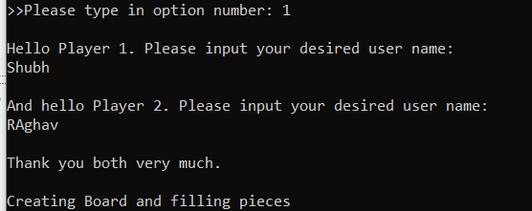
>>

Slide 7
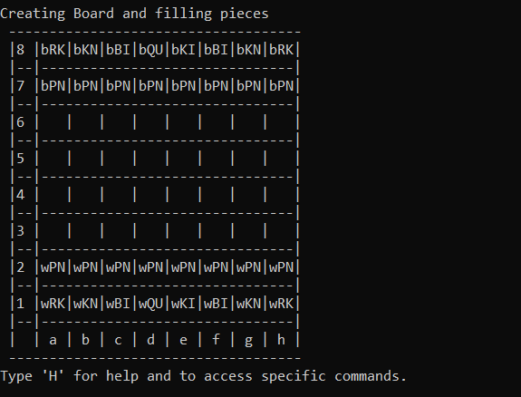
>>

Slide 8
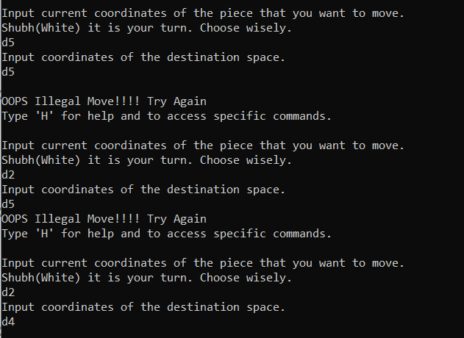
>>

Slide 9
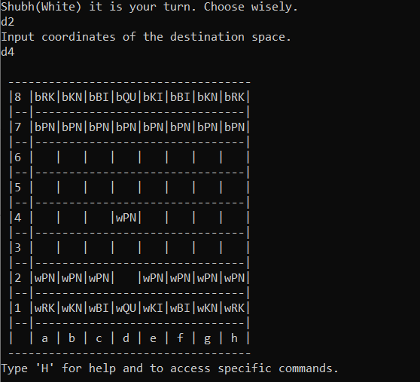
>>

Slide 10
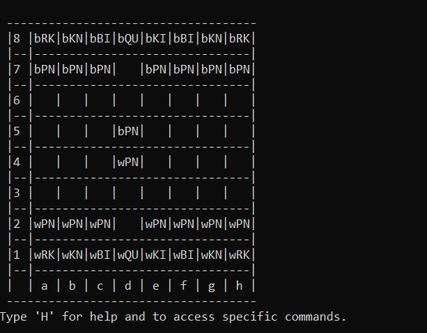
>>

Slide 11
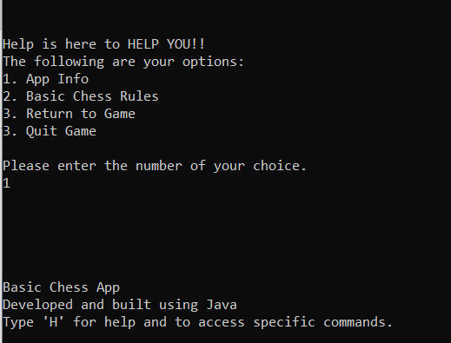
>>

Slide 12
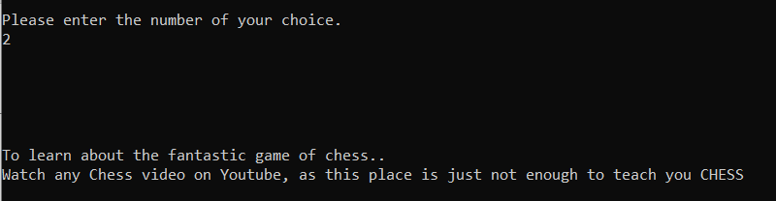
>>

Slide 13
END

